Slide 1
UPSWING FARMING
Ayush Gupta
Kavya Prakash
Mayank Gangrade

Slide 2
PROBLEM AND APPROACH
Growing population is widening the gap between the food demand and agricultural resources
According to the UN Food and Agriculture Organization, the world will need to produce 70% more food in 2050 than it does now SOLUTION
Improve food production by increasing the number of producers
Reduce wastage occurring from inefficient farming methods OUR APPROACH
Upswing farming encourages small scale farmers, home gardeners to register for events ,make an informed decision on farming methods, get answers on queries and making the entire process easier

Slide 3
USE CASES
Gardeners:
Gardeners are able to sign up and create and account on their own
Gardeners can see the top crops based on their area
They can rent land or put up their land for lease
They can see the crop prices in the market which is controlled by the state department
Once they make a decision on the crops to be grown they can check the farming methods for each crop
Anytime during the production they can post their queries on a forum which is answered by the farmers
They can then register for food collection drive events to sell their crops

Slide 4
USE CASES :
State department :
State department can approve funding requests from researchers
They create the crop collection drive events
They control the market by pricing the crops
Researcher :
Researcher is able to view the analytics
They can raise requests for funding
Farmers :
Farmers are able to answer the gardeners queries
They are able to sell their crops to buyers
Sellers :
1. Sellers are able to sell raw materials

Slide 5
OBJECT MODEL
Mail.jar
Util*
Util Functions*
Twillio API
Ecosystem
DB4OUtil
State
Configuration
City
Govt Department
Food Department
Gardener
Queue
Event Organization
Agriculture Department
Farmer
Funding Organization
Request
Research
Buyer
Seller
Land seller request
Funding Request
QA request
EventOrganizer
FarmerSell

Slide 6
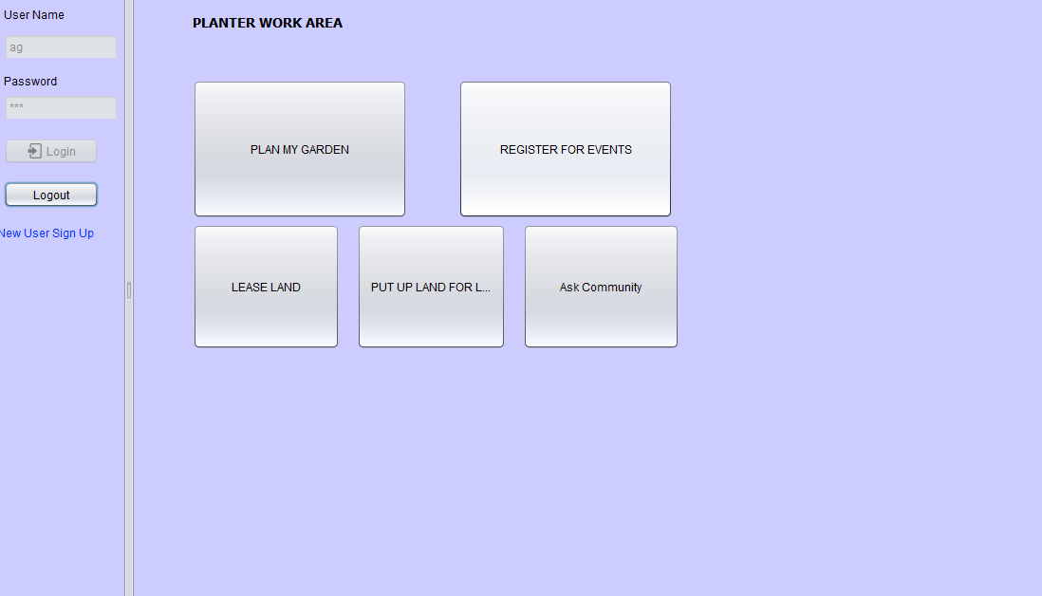
Project Snapshots:

Slide 7
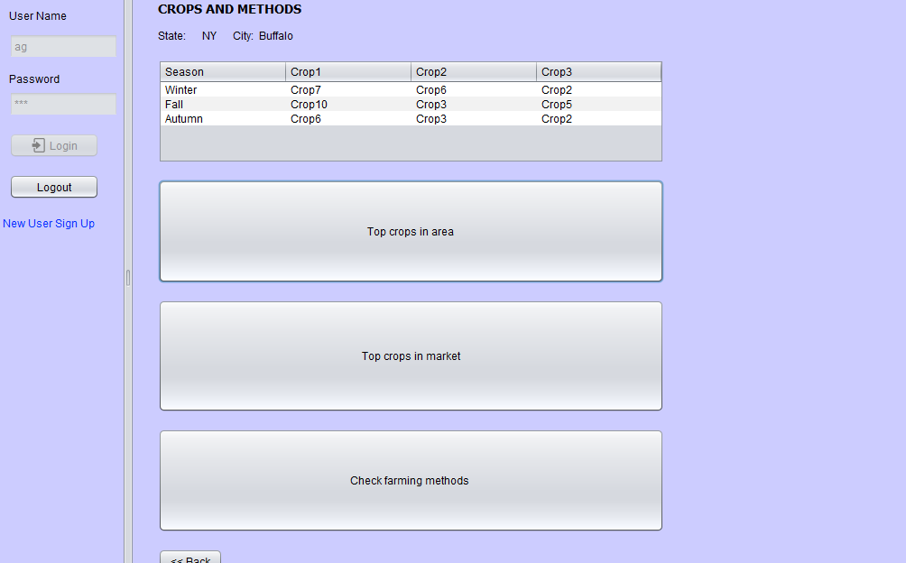

Slide 8
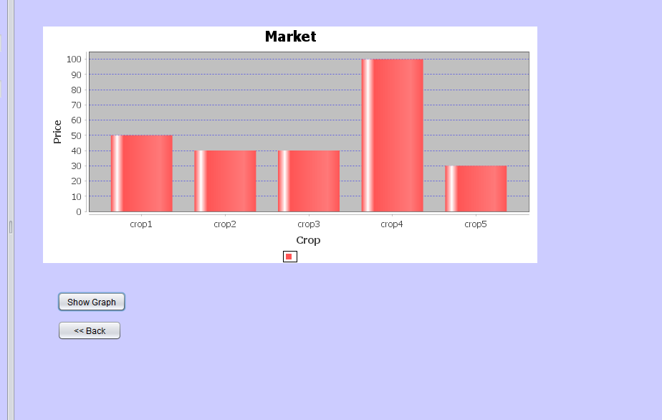

Slide 9
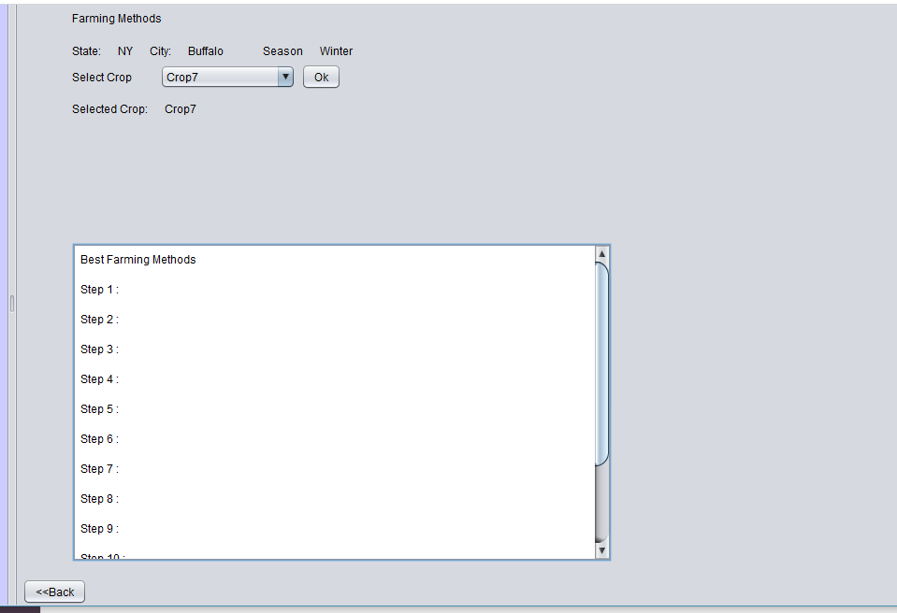

Slide 10
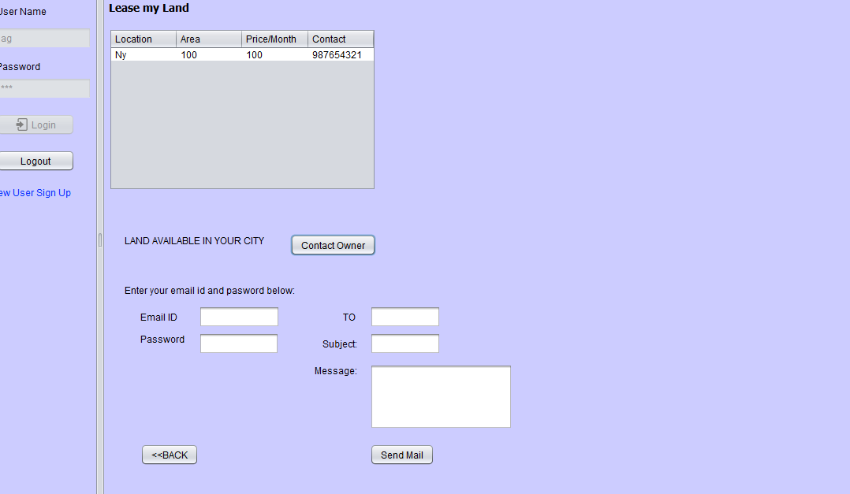

Slide 11
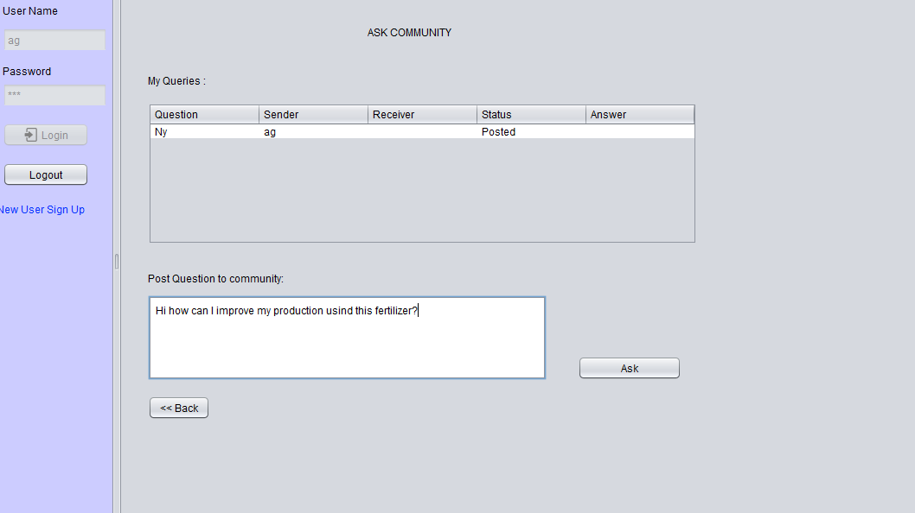

Slide 12
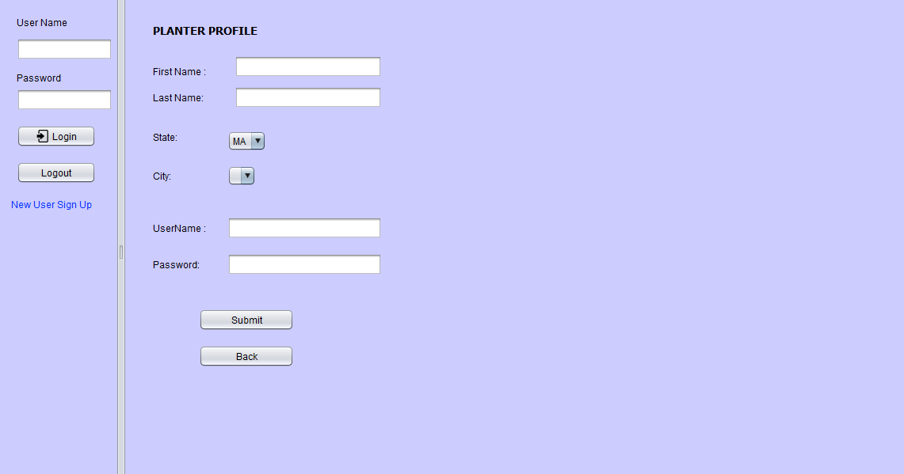

Slide 13
THANK YOU

